Slide 1

RentRadar: Revolutionizing the Rental Market in Kenya
A Full-Stack MERN Capstone Project by Faith Njeri

Slide 2

The Problem: Kenya's Rental Market is Broken
Scattered Listings
❌ Listings scattered across WhatsApp, Facebook, agents
Rampant Fraud
⚠️ Rampant fraud and unverified listings
Slow Communication
🐌 Slow, manual communication
No Centralized Tool
🤯 No centralized, trusted tool for renters

Slide 3
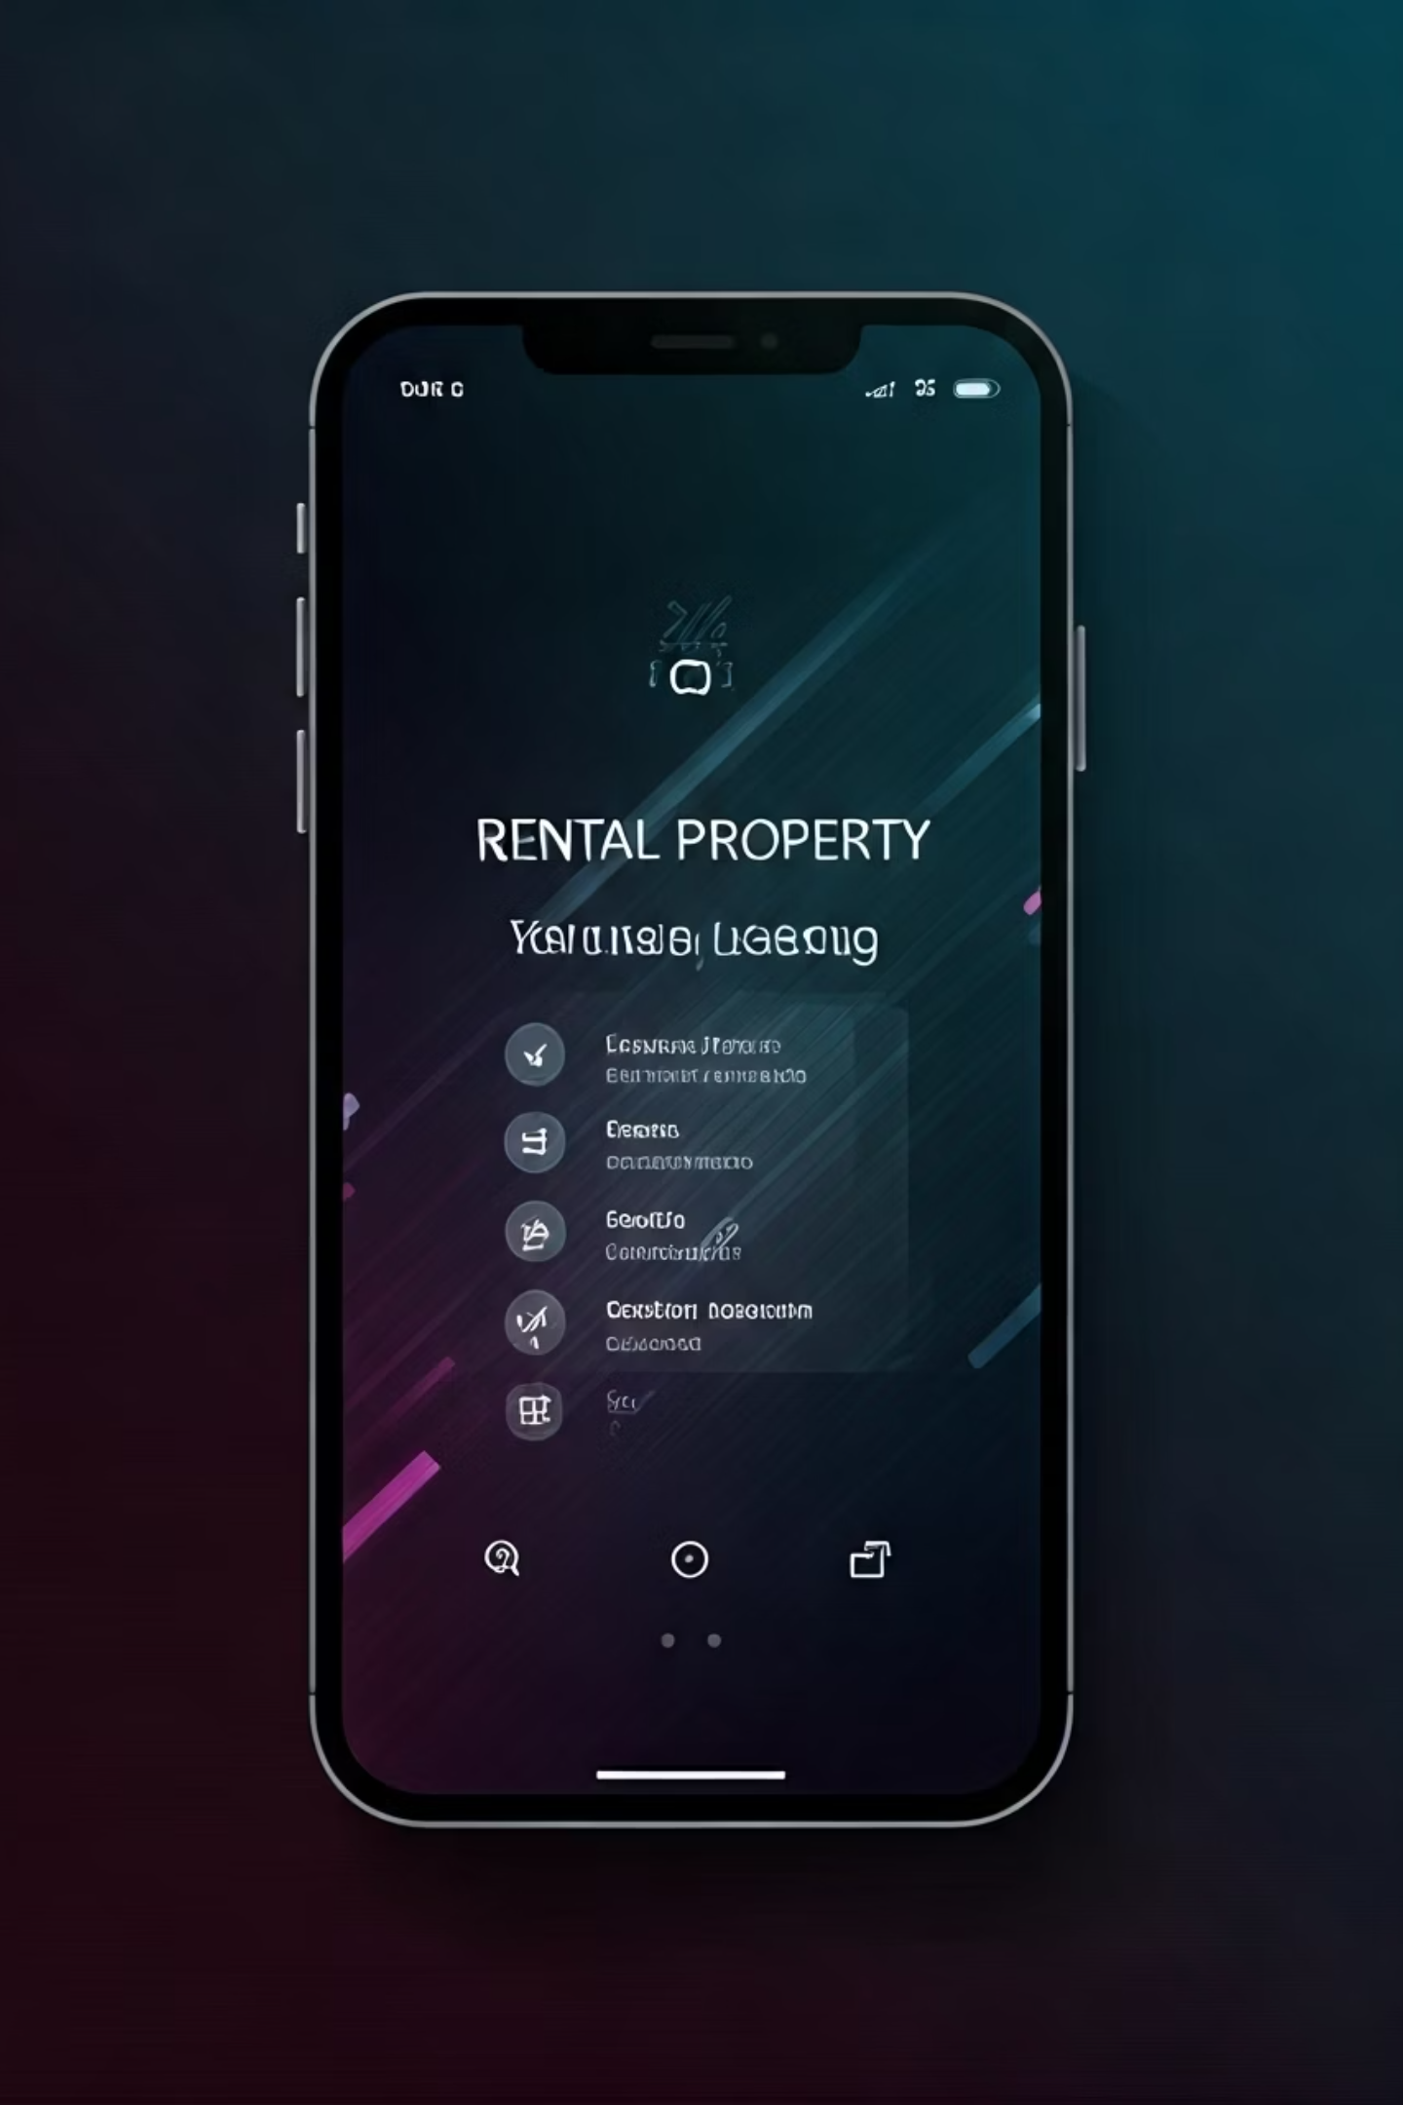
Our Solution – RentRadar
A secure, all-in-one web platform connecting renters to verified listings and professional agents.
🎯 Mission: Bring transparency, efficiency, and trust to the rental process in Kenya.

Slide 4





Core Features for Renters
Smart Search & Filters
🔍 Location, price, amenities
Map View
🗺️ Explore neighborhoods visually
Verified Listings
✅ Via community moderation
Book Viewings
📅 With trusted agents

Slide 5
Core Features for Agents & Community
For Agents
For Community
Dashboards to manage listings & track performance
🧩 Points for verified contributions
Public profiles with ratings & reviews
🏆 Leaderboard to encourage engagement

Slide 6






Technology Stack
Frontend
React + Vite + Tailwind + React Router
Backend
Node.js + Express.js + MongoDB + Mongoose
Security
JWT & bcryptjs for secure auth
Deployment
Netlify (frontend) + Render (backend)

Slide 7

DevOps & Testing
CI/CD with GitHub Actions
✅ Ensures stability and code quality with every commit
Testing Suite
🧪 Jest, Supertest, Vitest, React Testing Library

Slide 8




Key Challenges & Growth
Complex State Management
Debugging Production Deployments
Professional-Grade CI/CD Workflows
🧠 With React Context
🛠️ CORS, env vars
🚀 Built from scratch

Slide 9

Future Roadmap
Real-Time Notifications
1
📲 via Socket.io
2
In-App Chat
💬 for renters & agents
Advanced Admin Panel
3
🧑‍💼 For better management
4
Payment Integration
💳 M-Pesa / Stripe

Slide 10
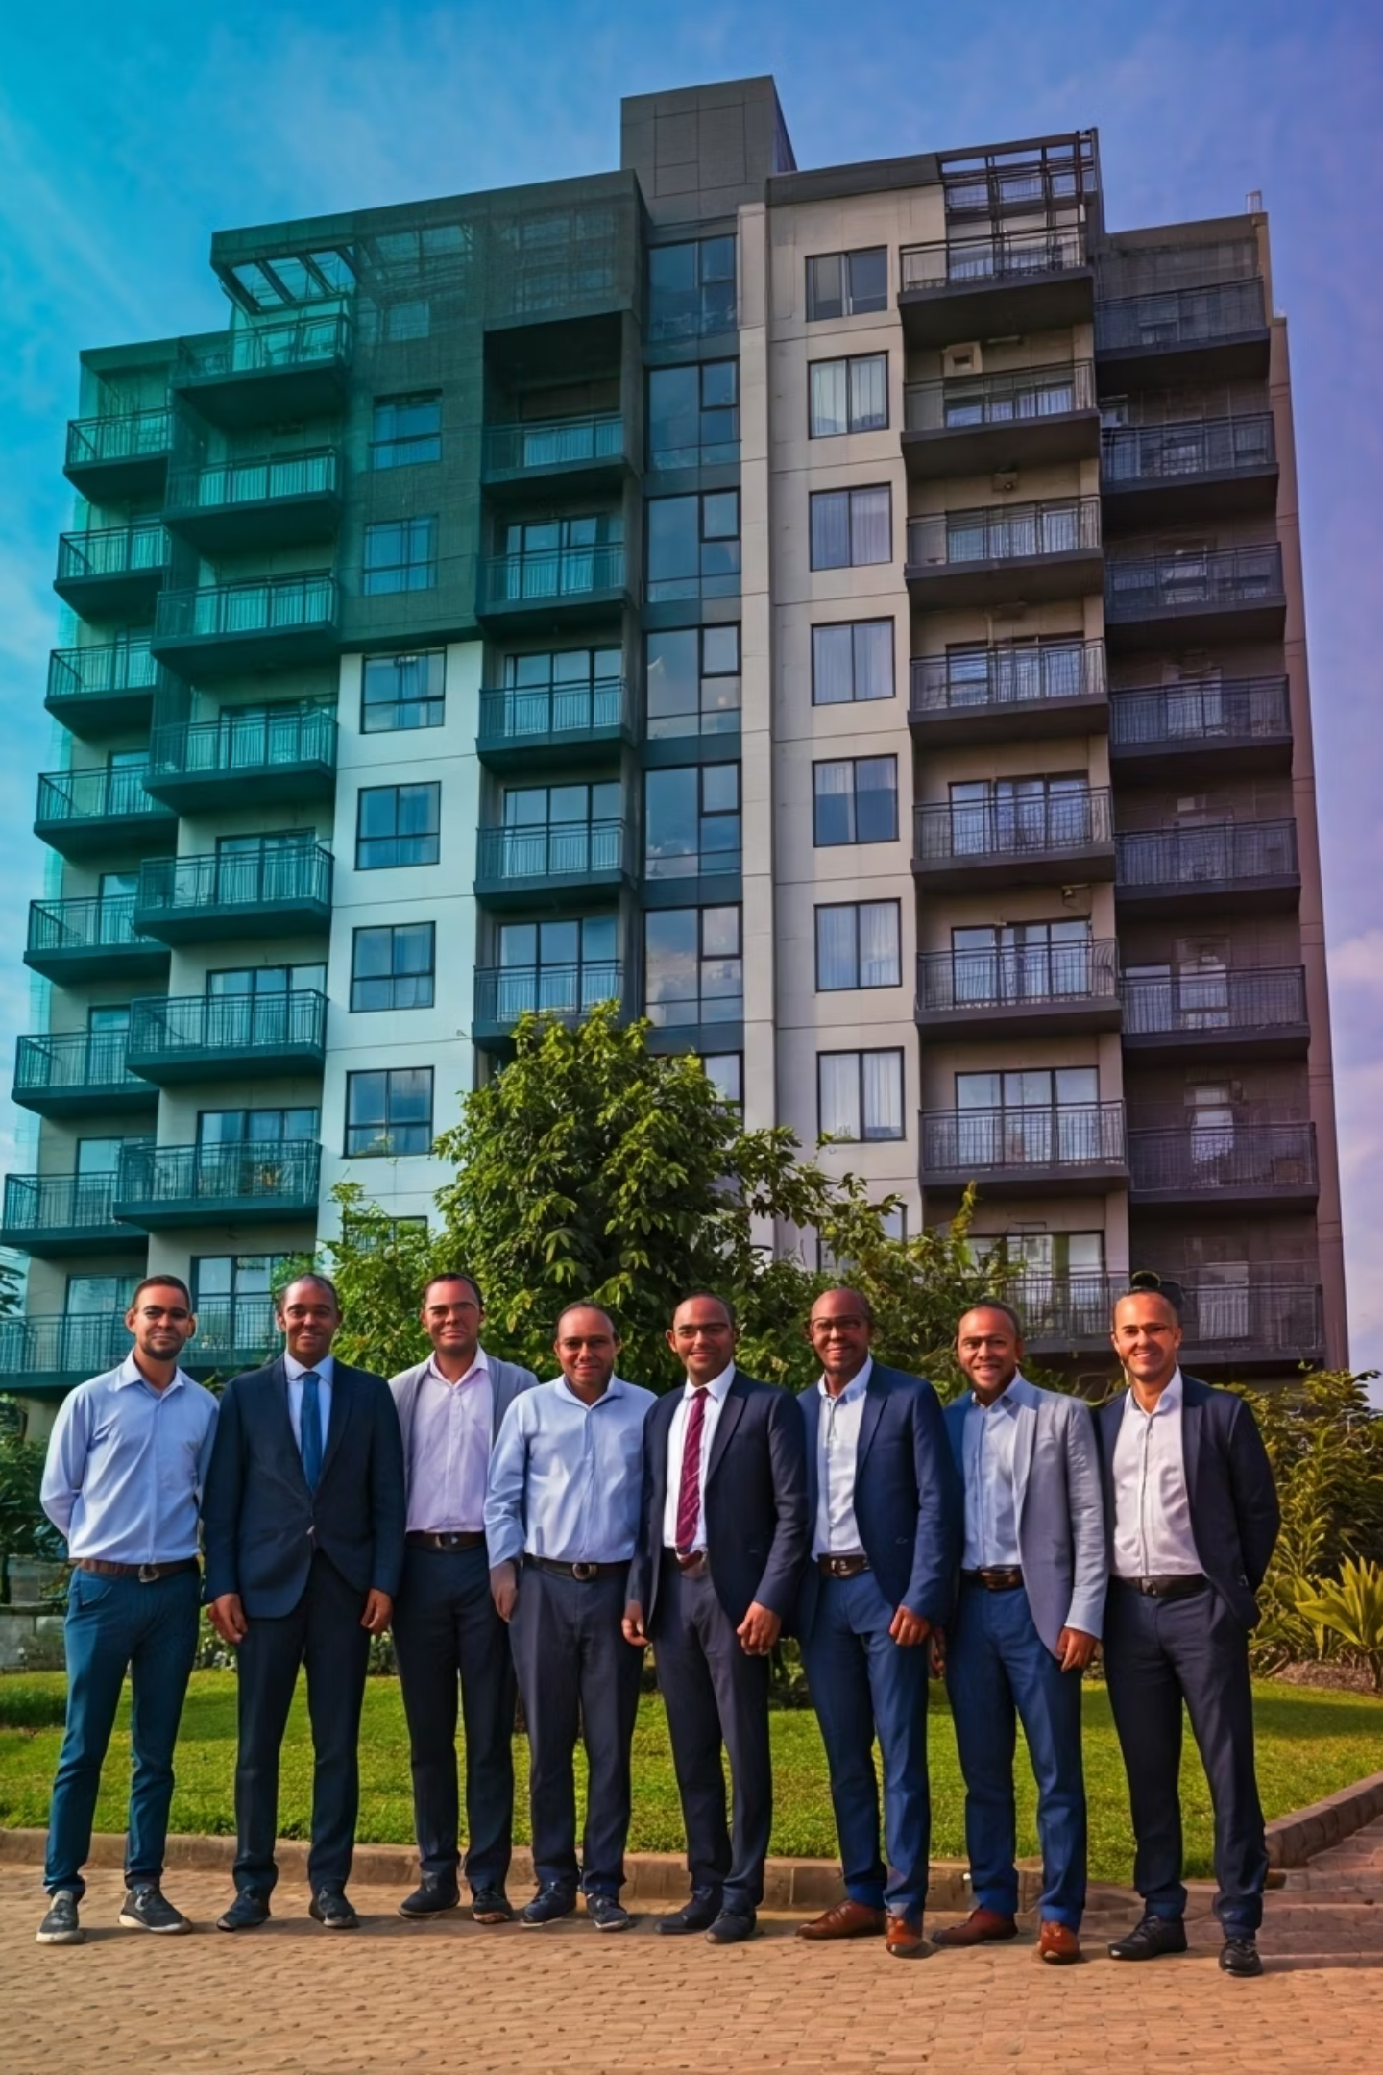
Thank You!
🌐 Live App: rentradar254.netlify.app
💻 Codebase: github.com/NjeriCodeCraft/rent-radar
🙏 Open to questions — let's build trust in housing together!

